Slide 1
GIT
POGHISHO

Slide 2
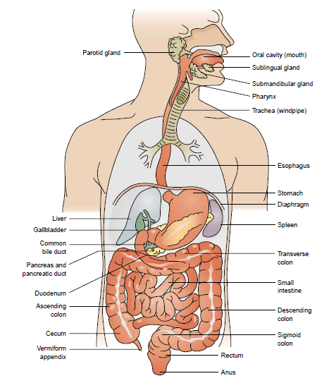
ANATOMY OF THE GIT

Slide 3
ACUTE ABDOMEN
A clinical term used to describe a syndrome mainly characterized by acute abdominal pain that causes the patient to be hospitalized within a few hours of the onset of pain
The diagnosis when made quickly reduces morbidity and mortality.
Although a specific diagnosis should be attempted, the immediate problem in management is to decide whether an 'acute abdomen' exists and whether surgery is required.

Slide 4
CAUSES OF ACUTE ABDOMEN
Acute appendicitis
Intestinal obstruction
Urinary tract infection
Gall bladder disease-cholecystitis ,liver abscess
Perforated ulcer

Slide 5
CLINICAL MANIFESTATIONS
Non specific abdominal pain - constant (usually owing to inflammation) or colicky because of a obstruction
Abdominal Distension
Guarding
Rigidity
Altered bowel sounds/habits
fever
tachycardia
raised white cell count
Hypovolaemia-a pale cold skin, a weak rapid pulse and hypotension

Slide 6
CLINICAL INVESTIGATIONS/DIAGNOSIS
U/E
Urinalysis
Plain abdominal x-ray
Abdominal paracentesis
u/sound

Slide 7
MANAGEMENT
Mainly conservative-NPO, IV fluids
Pain management
Laparotomy-e.g incase of perforation-depending on findings of paracentesis

Slide 8
Appendicitis
The appendix is a small finger like structure about 10 cm long attached to the cecum and just below the ileocecal valve
Because it empties inefficiently and its lumen is small thus prone to obstruction and infection
It is the most common reason for abdominal surgery

Slide 9
APPENDICITIS
ACUTE APPENDICITIS
the most common surgical emergency.
It affects all age groups.
CAUSES:
obstruction with a fecal material
generalized acute inflammation.

Slide 10
Pathophysiology
The appendix becomes inflamed and edematous as a result of becoming kinked or occluded by fecalith, tumor, lymphoid hyperplasia(growth by multiplication of cells), or foreign body.

Slide 11
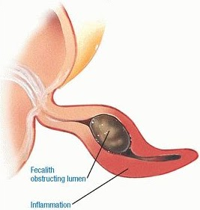
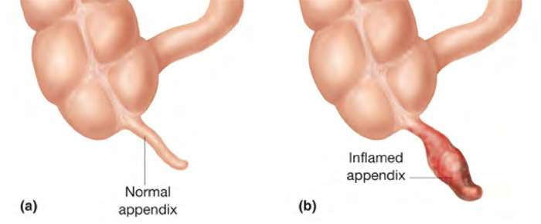
Fecalith obstructing lumen
inflammation

Slide 12
CLINICAL FEATURES
abdominal pain initially in the centre of the abdomen (epigastrium or periumbilical), becoming localized to the right iliac fossa in the first few hours
Nausea, vomiting, anorexia and occasional diarrhoea can occur
tenderness in the right iliac fossa/right lower quadrant, with guarding due to the localized peritonitis. There may be a tender mass in the right iliac fossa.
white cell count may be raised.

Slide 13
DIAGNOSIS
Clinical findings are nomally adequate to establish a diagnosis
Leukocytosis
neutrophilia
An ultrasound reveals an inflamed appendix/ appendix mass or other localized lesion.

Slide 14
MANAGEMENT
Management of pain
Pre-operative preparation
exploratory laparotomy with appendicectomy
laparoscopic removal of the appendix
Antibiotics
Other post operative care
For appendix mass- the patient is usually treated conservatively with intravenous fluids and antibiotics- pain subsides over a few days and the mass usually disappears over a few weeks.
If recurrent appendicitis occur then appendicectomy may be planned

Slide 15
COMPLICATIONS
gangrene with perforation
localized abscess
generalized peritonitis.

Slide 16
PERITONITIS
Inflamation of peritoneum
May be localised or generalized
CAUSES
infection e.g. perforated appendix, TB ETC (septic peritonitis)
chemical irritation due to leakage of intestinal contents e.g. Bile, gastric juices in perforated ulcer- (aseptic peritonitis) often complicated by additional infection from E. coli and Bacteroides
The peritoneal cavity becomes acutely inflamed, with production of inflammatory exudates that spreads throughout the peritoneum, leading to intestinal dilatation and paralytic ileus with severe scarring

Slide 17
Pathophysiology
It is caused by leakage of contents from abdominal cavity, usually as of inflammatory, infection, ischemia, trauma or tumor perforation. Edema of the tissues results and exudation of fluid develops in a short time. Fluid in the peritoneal cavity becomes turbid with increasing amounts of protein, white blood cells, cellular debris and blood.

Slide 18
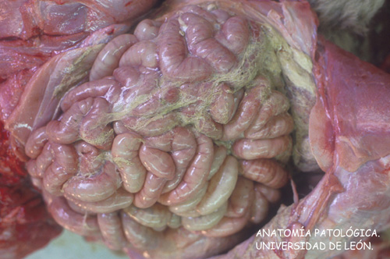
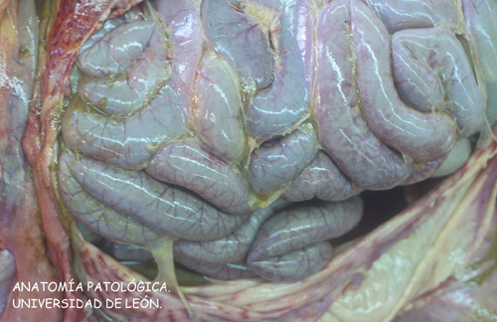
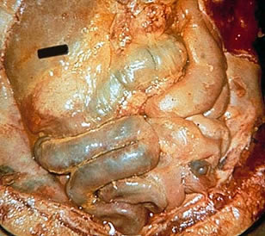
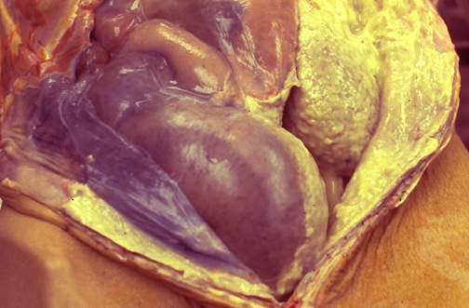

Slide 19
CLINICAL FEATURES
Pain- acute onset of abdominal pain
Acute tender abdomen
Abdominal distension
Altered bowel sounds reduced/absent
Guarding/rigidity
Circulatory collapse and shock.
The patient may improve temporarily, only to become worse later as generalized toxemia occurs.

Slide 20
MANAGEMENT
Pain management-analgesics
Laparotomy with peritoneal lavage of the abdominal cavity
Rehydration- /correction of shock,re-establishment of a good urinary output.
insertion of a nasogastric tube
antibiotics

Slide 21
Surgical Management
Remove the infected material or the cause
Fecal diversion (changing the direction that is to be follow) if there is extensive sepsis
Complications of surgery include:-
wound evisceration (to remove the inner organs of a body) and abscess formation

Slide 22
COMPLICATIONS – delay in treatment leads to:
profound toxaemia and septicaemia
local abscess formation - suspected if a patient continues to remain unwell postoperatively with a swinging fever, high white cell count and continuing pain

Slide 23
Intestinal obstruction
It exists when the blockage prevents the normal flow of intestinal contents through the intestinal tract

Slide 24
Small and Large Intestines
Small intestine (longest organ in the GI tract)
Three major divisions: duodenum, jejunum, ileum
Main function is complete digestion of food
Most nutrients and water are absorbed in 6- to 8- hour passage
Large intestine
Segments: cecum; appendix; ascending, transverse, descending, and sigmoid colon; rectum
Main functions are elimination of waste and absorption of water

Slide 25
Bowel Obstruction
Occurs in the small (most common) or large intestine (sigmoid colon most common)
Can be partial or complete
Severity depends on the region of the bowel, the degree of occlusion, and the degree of vascular disruption

Slide 26
Bowel Obstruction
In small bowel obstruction, large amounts of fluid and gases are trapped above the area of obstruction, leading to abdominal distention
Dehydration can develop from loss of water and sodium
Hypovolemia occurs as fluids are pulled from the vascular bed to the site of the obstruction
Peristalsis below the obstruction decreases, which leads to bacterial overgrowth and may lead to peritonitis
If the blood supply is cut off, it can lead to necrosis

Slide 27
Causative Factors
Extrinsic bowel obstruction
Begins outside the GI tract
Adhesions, herniations, or masses
Intrinsic bowel obstruction
Lumen blockage
Caused by acute or chronic bowel disease inflammation, congenital defects, or tumors
Intraluminal bowel obstruction
Caused by the inability of material to pass through the GI tract (meconium, foreign bodies, impactions)

Slide 28
Mechanical Causes
Adhesions: Loops of intestine become adherent to areas that heal slowly or scar after abdominal surgery (most common cause of small bowel obstruction)
Herniations: The intestine protrudes through a weakened area in the abdominal muscle or wall
Volvulus: Bowel twists and turns on itself; laxative use may be the cause
Intussusceptions: Bowel slips into itself
Tumors
Diverticulitis: Pouches push out of mucosal lining of bowel

Slide 29
Functional Causes
Intestinal muscles are unable to propel contents forward, such as in:
Muscular dystrophy
Endocrine disorders (such as diabetes)
Neurological disorders (such as Parkinson’s disease)
Electrolyte imbalances
Uremia
Spinal cord lesions

Slide 30
INTESTINAL OBSTRUCTION
CAUSE:
Most are due to mechanical block-worms
Malfunctional bowel following surgery (adhesions)
other causes e.g carcinomas, sigmoid volvulus etc

Slide 31
Classification
Cause of obstruction : mechanical or functional ( Ileus ).
Duration of obstruction: acute or chronic.
Extent of obstruction : partial or complete
Type of obstruction : simple or complex (closed loop and strangulation) .

Slide 32
Small bowel obstruction
Pathophysiology
Intestinal contents, fluids, and gas accumulate above the intestinal obstruction, the abdomen distends, fluid retention reduces fluid reabsorption leading to stimulation of gastric secretion. More pressure builds, leading to pressure on the intestinal lumen leading to decrease venous and arteriole capillary pressure that lead to edema, congestion, necrosis and eventually perforation

Slide 33

The four cardinal features of intestinal obstruction:
-abdominal pain
-vomiting
-distension
-constipation
Vary according to:-
location of obstruction
Duration of obstruction
underlying pathology
intestinal ischemia

Slide 34
CLINICAL FEATURES
abdominal colic
vomiting and constipation without passage of wind
Profuse Vomiting in the upper gut obstruction -absent in the lower GI obstruction-vomitus may be contain bile or fecal material
Abdominal distension with increased bowel sounds.
Constipation
Fever in prolonged obstruction
abdominal pain
Features of dehydration
X-ray of the abdomen reveals distended loops of bowel proximal to the obstruction.

Slide 35
MANAGEMENT
Resuscitation with intravenous fluids (mainly isotonic saline with potassium)
Decompression with NG Tube
conservative management above wth e.g enema
4. laparotomy
Partial /incomplete intestinal obstruction that can be managed conservatively.
colostomy may be required In critically ill patients
Volvulus of the sigmoid colon can be managed by the passage of a flexible sigmoidoscope or a rectal tube to un-kink the bowel
multidisciplinary approach to management is required e.g in enteral and parenteral

Slide 36
PEPTIC ULCER DISEASE
Is an excavation that forms in the mucosal wall of the stomach, pylorus and in the duodenum
Classified into gastric, duodenal, or esophageal ulcer, depending on its location
Other forms of ulcers exist e.g stress ulcers, curlings ulcers
There is Erosion of a circumscribed area of mucous membrane that may extend as deep as the muscle layers or to the peritoneum.

Slide 37
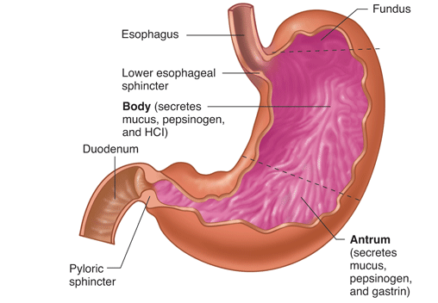
STRUCTURE OF THE STOMACH AND DUODENUM

Slide 38
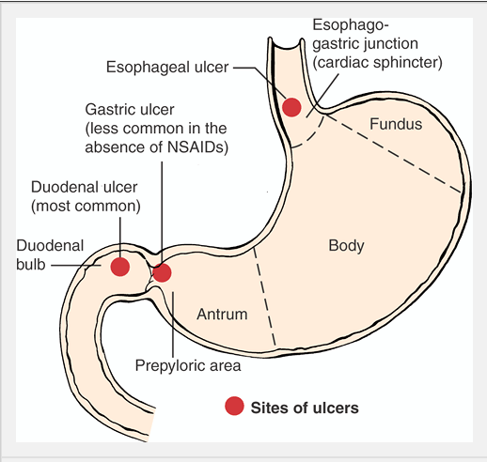
SITES OF ULCERS FORMATION

Slide 39
CAUSES OF PUD
KNOWN CAUSES
H. pylori infection-present in most patients with peptic ulcer disease.
NSAID-induced injury
Gastric acid secretory abnormalities e.g Zollinger-Ellison syndrome especially in duodenal ulcers

Slide 40
RISK FACTORS
drugs (NSAIDs, prolonged high-dose corticosteroids)
family history
Cigarettes
Stress
lower socioeconomic status
Increased alcohol intake
caffeine

Slide 41
PATHOGENESIS
H. pylori- produces toxins,adherence factors and urease that converts urea to ammonia-The ammonia produced neutralizes the gastric acid acid facilitating penetration in to the gastric mucosa
is motile with a flagella and has proton pumps that extrudes acids from the mucosal cells into epithelial side
At the mucosa, it causes epithelial cell damage by local release of cytokines such as IL-6 and IL-8 causing severe inflamation facilitating mucosal damage

Slide 42
There is Increased acid secretion because of:
increased parietal cell mass
increased gastrin secretion by increased gastrin activity coz of toxin induced inhibition of somatostatin (that normally inhibit gastrin secretion)
Decreased production of bicarbonate in the duodenum increases the tissue damage by excess acid not neutralized

Slide 43
GENERAL SIGNS AND SYMPTOMS
Burning epigastric pain occurring 1 to 3 hours after a meal
Nocturnal epigastric, abdominal pain or burning. May awaken patient at night, usually around midnight to 3 a.M.
Epigastric tenderness
Early satiety
Anorexia
Weight loss
Heartburn

Slide 44
Belching (may indicate reflux disease)
Dizziness, syncope
Hematemesis, or melena (may indicate hemorrhage)
Anemia
Sudden, intense mid-epigastric pain radiating to the right shoulder may indicate ulcer perforation.

Slide 45
DIAGNOSIS
Upper GI endoscopy with -tissue biopsy and cytology.
Upper GI radiographic examination (barium study)
H-Pylori test-urease test
Serial stool specimens to detect occult blood
Gastric secretory studies (gastric acid secretion test and serum gastric level test)-elevated in Zollinger-Ellison syndrome

Slide 46
DUODENAL ULCERS
Incidence
Age30-60 yrs
80% of peptic ulcers are duodenal
CLINICAL FEATURES
Hypersecretion of stomach acid(HCl)-gastrinomas
May have weight gain
Pain occurs 2–3 hours after a meal; often awakened between 1–2 AM; ingestion of food relieves pain

Slide 47
Vomiting uncommon
Hemorrhage less likely than with gastric ulcer, but if present melena more common than hematemesis
More likely to perforate than gastric ulcers
Risk Factors
H. pylori, alcohol, smoking, cirrhosis, stress

Slide 48
GASTRIC ULCERS
INCIDENCE
Usually 50 years and over
Male: female 1:1
15% of peptic ulcers are gastric
Normal—hyposecretion of stomach acid (HCl)
Weight loss may occur
Pain occurs 1⁄2 to 1 hour after a meal; rarely occurs at night; may be relieved by vomiting; ingestion of food does not help, sometimes increases pain

Slide 49
Vomiting common
Hemorrhage more likely to occur than with duodenal ulcer hematemesis more common than melena
Risk factors
H. pylori, gastritis, alcohol, smoking, use of NSAIDs

Slide 50
OTHER TYPES OF ULCERS
Stress ulcer -the acute mucosal ulceration of the duodenal or gastric area that occurs after physiologically stressful events, such as burns, shock, severe sepsis, and multiple organ traumas.
Shallow erosions of the stomach normally occur after stressful event and increase as the situation persists they however clear when the stressful event is over
Curling’s ulcer is frequently observed about 72 hours after extensive burns and involves the antrum of the stomach or the duodenum.
Etiology is not known but is thought to occur as a result of reduced mucosal blood flow

Slide 51
MANAGEMENT
Pharmacological management-Current regimens are triple therapy with a PPI along with two antibiotics for 1 week
omeprazole 20 mg + metronidazole 400 mg and clarithromycin 500 mg (all twice daily)
omeprazole 20 mg + clarithromycin 500 mg and amoxicillin 1 g (all twice daily).
bismuth salts -suppresses or eradicates H. pylori-coats the ulcers
Antacids-magnesium/aluminium salts
Histamine 2 (H2) receptor antagonists-e.g ranitidine
Eliminate use of NSAIDS or other causative drugs.

Slide 52
Well-balanced diet with meals at regular intervals.
Avoid dietary irritants
Lifestyle modification-cessation of smoking/drinking alcohol (impairs healing –causes scarring).
Partial gastrectomy/Vagotomy-resection of vagus nerve

Slide 53
TREATMENT

Slide 54
GOALS OF TREATMENT
Lowering the amount of acid that stomach makes,
Neutralizing the acid
protecting the injured area so it can heal
It's also very important to stop smoking and drinking alcohol
Prevent complications (bleeding, perforation, penetration, obstruction)
Minimize recurrences
Reduce financial costs

Slide 55
Antibiotic medications. Combinations of antibiotics to treat H. pylori because one antibiotic alone isn't always sufficient to kill the organism.
-amoxicillin (Amoxil), clarithromycin (Biaxin) and metronidazole (Flagyl). Combination drugs that include two antibiotics together with an acid suppressor or cytoprotective agent (Helidac, Prevpac) have been designed specifically for the treatment of H. pylori infection.

Slide 56
Acid blockers. Also called histamine (H-2) blockers — reduce the amount of HCL released into GI. This relieves ulcer pain and encourages healing.
MOA: keeping histamine from reaching histamine receptors.
NB: Histamine is a substance normally present in body. When it reacts with histamine receptors, the receptors signal acid-secreting cells in stomach to release hydrochloric acid. Available by prescription or over-the-counter (OTC), acid blockers include the medications ranitidine (Zantac), famotidine (Pepcid), cimetidine (Tagamet) and nizatidine (Axid).

Slide 57
Antacids. An antacid may be taken in addition to an acid blocker or in place of one. Instead of reducing acid secretion, antacids neutralize existing stomach acid and can provide rapid pain relief.

Slide 58
Proton pump inhibitors. Reduce acid by blocking the action of these tiny pumps. These drugs include the prescription and over-the-counter medications omeprazole (Prilosec), lansoprazole (Prevacid), rabeprazole (Aciphex) and esomeprazole (Nexium). They also inhibit H. pylori.

Slide 59
Cytoprotective agents. Protect the GI mucosa.
sucralfate (Carafate) and misoprostol (Cytotec). bismuth subsalicylate (Pepto-Bismol).

Slide 60
Bowel rest: Bed rest and clear fluids with no food at all for a few days. This gives the ulcer a chance to start healing without being irritated.
Nasogastric tube: Decompression
Urgent endoscopy or surgery if indicated: Damaged, bleeding blood vessels can usually be repaired with an endoscope. The endoscope has a small heating device on the end that is used to cauterize a small wound.

Slide 61
Surgery
Vagotomy
Antrectomy
Pyloroplasty
Tying off an
artery
Other modes
Of treatment
Acupuncture
Chiropracting
Homeopathy
Herbs
Notes:
Chiroprotractor deals with the disorders of the MS and Nervous systems. Manipultes for example spinal joints that have become hypomobile due to injury etc
Using irritants to cure the dsame condition

Slide 62
LIFE STYLE AND HOME REMEDIES

Slide 63
Use of Olive Oil
Don't smoke
Limit or avoid alcohol
Less
Coffee and
Carbonated
Beverages
Avoid nonsteroidal
anti-inflammatory
drugs (NSAIDs)
Exercise
Fruits and
Vegetables
Stress Relief

Slide 64
COMPLICATIONS OF PUD
Hemorrhage
Perforation
Gastric outlet obstruction-with metabolic alkalosis
COMPLICATIONS OF GASTRECTOMY
Recurrent ulcer
Dumping syndrome
Wight loss-due to persistent anorexia, vomiting
Anemia-poor iron absorption
Vit B12 deficiency-lack of intrinsic factor
Low follate absorption

Slide 65
Gastroesophageal Reflux Disease (GERD)
Is a spontaneous regurgitation of the gastric contents into the esophagus
In young infants it’s physiologically normal unless it is complicated
If it occurs in children and adults it’s pathological/abnormal
Causes
Physiologic causes
Increased transient relaxation of the lower esophageal sphincter tone
Delayed gastric emptying
Increased gastric outlet sphincter tone
Pathologic causes
Gastric dysmotility – impaired gastric motility
Lower esophageal stricture

Slide 66
Gastroesophageal Reflux Disease (GERD)
Is a spontaneous regurgitation of the gastric contents into the esophagus
In young infants it’s physiologically normal unless it is complicated
If it occurs in children and adults it’s pathological/abnormal
Causes
Physiologic causes
Increased transient relaxation of the lower esophageal sphincter tone
Delayed gastric emptying
Increased gastric outlet sphincter tone
Pathologic causes
Gastric dysmotility – impaired gastric motility
Lower esophageal stricture

Slide 67
S & S
Heart burn
Regurgitation
Positive acid test
Diagnosis
Hx and clinical findings
Acid test
Barium studies e.g. barium meal to assess GIT continuity
Continuous esophageal pH monitoring

Slide 68
Management
Manage causative factors
Postural management – elevation of the head to reduce regurgitation
Modified diet – to avoid delayed absorption and gastric emptying
Administer antacids and other acid suppressant drugs
If the condition is severe surgery may be performed

Slide 69
Complications of GERD
Esophagitis due to chronic reflux
Anemia secondary to esophageal bleeding
Failure to thrive
Respiratory distress which may be secondary to aspiration pneumonia

Slide 70
Obstruction by hernias
Hernia is a general term used to describe a bulge or protrusion of an organ through the structure or muscle that usually contains it.

Slide 71
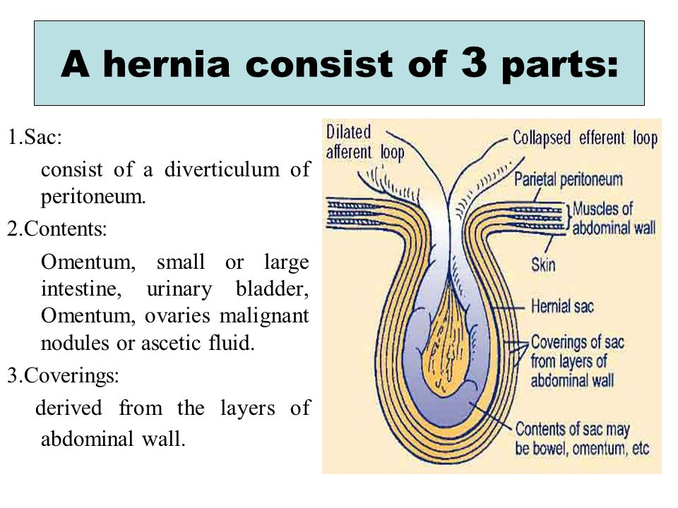

Slide 72
Accounts for 20% of SBO
Commonest 1. Femoral hernia
2. direct / indirect inguinal
3. Umbilical
4. Others: incisional (ventral)
Site of obstruction is the neck of hernia
The compromised viscus is within the sac.
Notes:
-volvulus: Intestinal volvulus is defined as a complete twisting of a loop of intestine around its mesenteric attachment site.
-incarceration: passage of a loop of intestine through a small orifice, e.g. inguinal canal, with resulting swelling, obstruction and occlusion of blood supply
-Obstruction:partial or complete blockage of the bowel that prevents the contents of the intestine from passing through
-intussusception: process in which there is telescoping of a proximal segment of intestine invaginates into the (distal) adjoining intestinal lumen

Slide 73
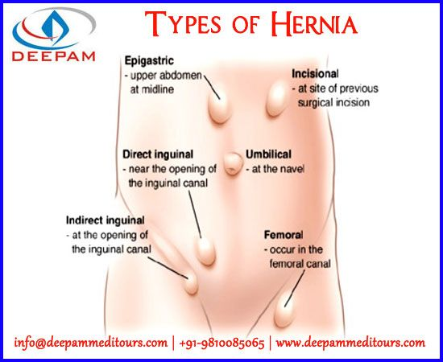

Slide 74
Terms in hernia
Reducible: A hernia that can be gently pushed back into place or that disappears when the person lies down.
Irreducible: Emergency
Incarcerated: That has mild symptoms does not exaggerate on coughing; reducible but has fecal content.
Strangulated:The intestine is blocked and the blood supply cut off. Emergency

Slide 75
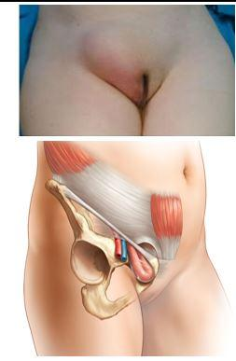
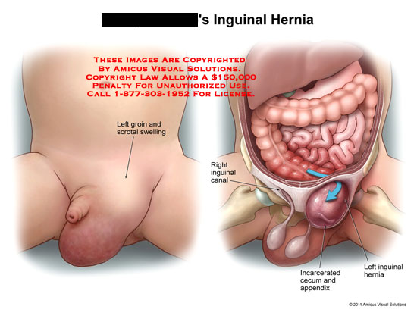
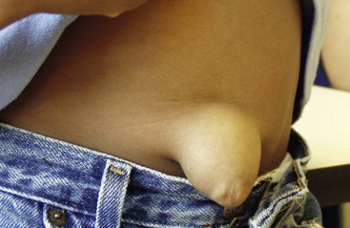
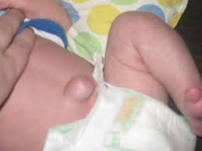
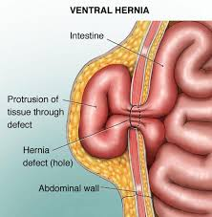

Slide 76
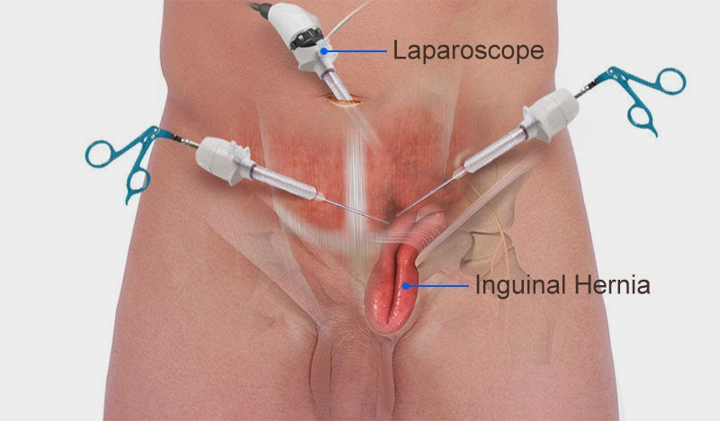
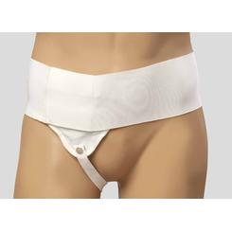
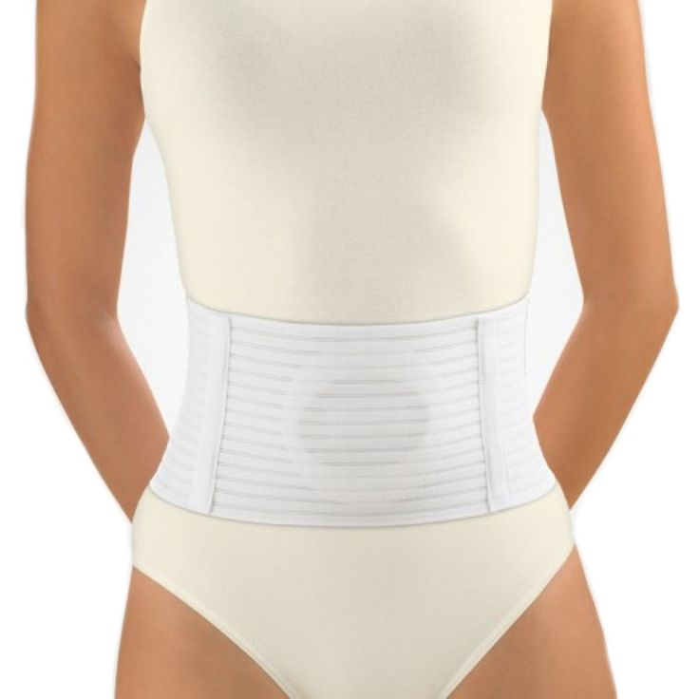
Management
Conservative: pressure
Herniorrhaphy
Surgery: Herniotomy
Herniorraphy
Hernioplasty

Slide 77
HERNIA
DEF.a hernia is a protrution of any part of any organ through a weak point or a perfuse in the surrounding structure.
Site of hernia
i) Inguinal hernia-The weak point is the inguinal canal which contains the spermatic cord in the male and round ligament in the female. It occurs more commonly in male than in female
Ii) Femoral hernia-Occurs when there is protrusion through the ring into the femoral canal
iii)Incision hernia-This caused by repeated stretching of the fibrous tissue formed after previous abdominal survey.
iv) Diaphragmatic or hiatus hernia This is the protrution of a part of the fundus of the stomach through the esophageal opening in the diaph

Slide 78
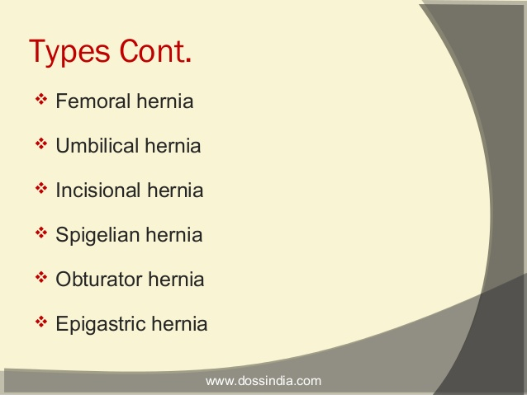

Slide 79
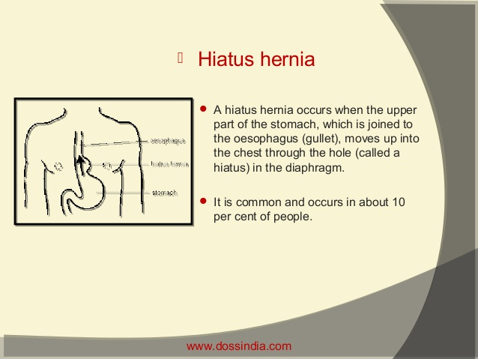

Slide 80
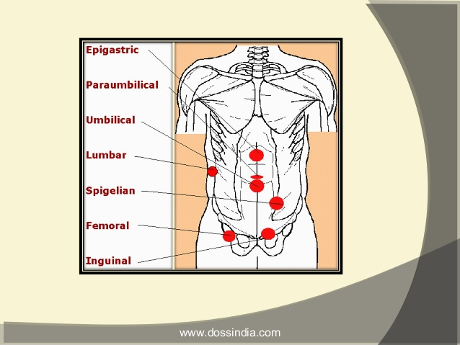

Slide 81
Hernia is classified into three types: * Reducible, Hernias- can be reducible if the hernia can be easily manipulated back into place.
* Irreducible or incarcerated- this cannot usually be reduced manually because adhesions form in the hernia sac.
* Strangulated-if part of the herniated intestine becomes twisted or edematous and causing serious complications, possibly resulting in intestinal obstruction and necrosis.

Slide 82
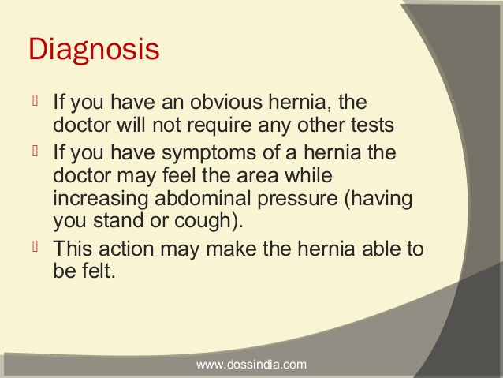

Slide 83
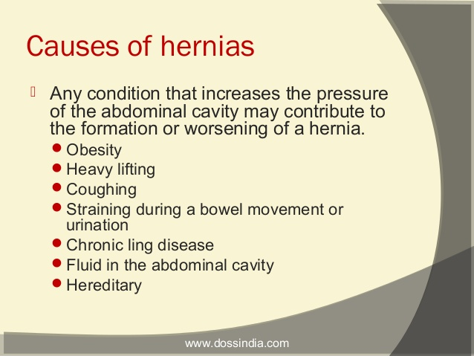

Slide 84
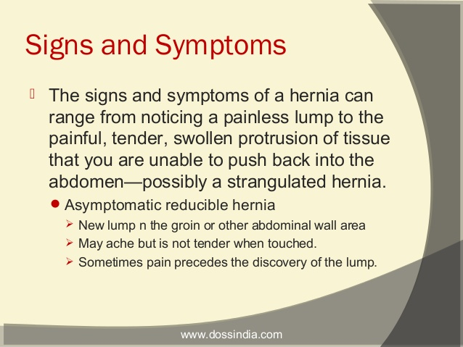

Slide 85
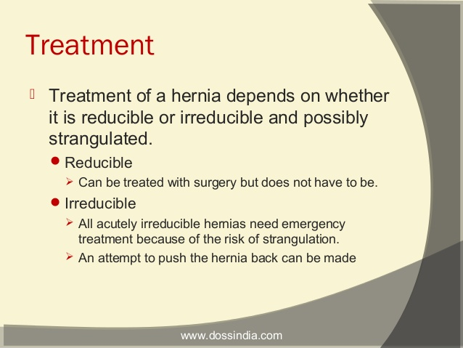

Slide 86
cancer of the esophagus
It is the carcinoma of oesophagus
Pathophysiology
Esophageal cancer of two types:-
Adenocarcinoma
Squamous cell carcinoma
The risk factors include gastro esophageal regurgitation ,chronic esophageal irritation, alcohol and use of tobbacco
These tumour cell sometimes penetrate the esophageal mucosa into the lymphatics
Later perforations and obstructions occur and erosion into great vessells

Slide 87
Clinical features
Ulcerated lesions of the oesophagus
Dysphagia initially with solid foods
Sensation of a mass in the throat
Substernal pain or fullness
Regurgitation of undigested feeds
Halitosis and hiccups
As the tumour grows, even swallowing of liquid feeds become difficulty
Hemmorrhage may take place
Weight loss
Respiratory difficulty

Slide 88
Assessment and diagnostic findings
OGD with biopsy
CT scan
Endoscopy

Slide 89
Medical management
At early stages goal is directed at cure
Treatment may include-surgery, chemotherapy radiation or a combination
Newly diagnosed:-preoperative combination chemotherapy and radiation therapy for 4-6 weeks followed by a period of no medical intervention for 4 weeks and lastly surgical resection of the eosophagus

Slide 90
Nursing management
Preoperatively- improve patients nutritional status as the patient is prepared for surgery, chemotherapy or radiation
High calorie and high protein diet is maintained
Nutritional status is maintained throughout treatment
Postoperatively put the patient in semi-fowler posistion
Monitor the patient for regurgitation and dyspnea
Feed the patient through the NGT by starting with oral sips.

Slide 91
Cancer of the oesophagus
Occurs 3 times in men than in women
Associated with alcohol and tobacco use
Risk factors
Ingestion of hot foods
Poor oral hygiene

Slide 92
Ca esophagus contd….
Exposure to nitrosamines
Cigarette smoking
Chronic alcohol consumption
Pathophysiology
Starts as a small growth usually in the squamous layer. Tumor spreads rapidly due to lack of serosa layer. Spread is through lymphatic and the systemic circulation. Inner layer invasion causes ulceration, later the whole wall is invaded. There is hypertrophy of the affected cells

Slide 93
S/S
Diagnosis
Biopsy
CT chest
Endoscopic ultrasound
Management
-Surgical
-Pain
Dysphagia
Sensation of a mass in the throat
Sub sternal pain
Regurgitation of undigested food
Hiccups
Foul smell
Dyspnea
Hemorrhage

Slide 94
Post –op care
Complications
Aspiration pneumonia
Esophageal obstructions
Tracheo-esophageal fistulas
Observations
NBM
Intercostal drain management
Pain control
Antibiotics
IV fluids
Removal of stitches on the 10thday
Other nursing care per the patients needs

Slide 95
Cancer of the stomach
It is the cancer of the stomach wall
It is always adenocarcinoma
40% develop in the lower part, 40% in the middle part, 15% in the upper part
The tumour infiltrates the surrounding mucosa, penetrating the wall of the stomach and adjacent organs and structures
The liver, esophagus, pancrease, and duodenum and adjacent structures are affected by the time diagnosis is made

Slide 96
Clinical manifestations
Dyspepsia
Early satiety
Weight loss
Abdominal pain
Anorexia
Bloating after meals
Nausea and vomiting

Slide 97
Assessment and diagnostic
Palpable mass
CT scan
Upper GI endoscopy

Slide 98
Medical management
Open surgical resection to remove the affected tissue
If surgery is not possible chemotherapy is initiated
Radiotherapy is used for palliation in patient with obstruction, GI bleeding secondary tumour and significant pain

Slide 99
Nursing interventions
Reducing anxiety -a relaxed, non threatening atmosphere is provided to the patient can express the concerns and the fears possibly anger about diagnosis and prognosis
Promoting optimal nutrition-the nurse encourages the patient to eat small, frequent portions of non irritating food to decrease gastric irritations. Foods high in calories, protein and rich in vitamins
If total gastotectomy is done Vit B12 is injecetd for life.
Assess signs for dehydration and correct it

Slide 100
Relieving pain; administer analgesics as prescribed to relieve pain, assess the frequency, intensity and duration of pain. Work with the patient and utilize non pharmacological methods of pain relief
Providing pschosocial support:-help the patient express fears, concerns and grief about the diagnosis by answering questions honestly and encourage the patient to participate in medical management
Promote home and community based care:
Educate patient about self care and continuity of care

Slide 101
Amebiasis
Is a parasitic infection of the intestines caused by the protozoan Entamoeba histolytica, or E. histolytica
Persons at greatest risk for amebiasis include:
people who have traveled to tropical locations with poor sanitation
immigrants from tropical countries with poor sanitary conditions
people who live in institutions with poor sanitary conditions, such as prisons
men who have sex with other men
people with compromised immune systems and other health conditions

Slide 102
Causes
E. histolytica is a single-celled protozoan that usually enters the human body when a person ingests cysts through food or water.
Transmission is also possible during anal sex or colonic irrigation.

Slide 103
Pathophysiology
When cysts enter the body, they lodge in the digestive tract. They then release an invasive form of the parasite called a trophozite. The parasites reproduce in the digestive tract and migrate to the large intestine. There, they can burrow into the intestinal wall or the colon. This causes bloody diarrhea, colitis, and tissue destruction. The infected person can then spread the disease by releasing new cysts into the environment through infected faeces

Slide 104
Symptoms of Amebiasis
loose stools and stomach cramping.
If the parasite invades the lining of your intestine, it can produce amebic dysentery

Slide 105
Assessment and diagnosis
History taking
Stool for ova and cyst
Colonoscopy

Slide 106
Management
Fluid and electrolyte replacement, gastric suction and blood transfusion may be required.
Diloxanide furoate is the drug of choice for asymptomatic patients with E. histolytica cysts in the faeces (metronidazole and tinidazole are relatively ineffective).
Metronidazole is the first choice for treatment of acute invasive amoebic dysentery.
Tinidazole is also effective.Treatment with metronidazole or tinidazole is followed by a 10-day course of diloxanide furoate to destroy any amoebae in the gut.
Diloxanide furoate is also given as a 10-day course for chronic infections.

Slide 107
Prevention
Successful control of amoebiasis depends on prevention of infection through adequate sanitation, safe food and water and good personal hygiene of the population.

Slide 108
Liver cirrhosis
Cirrhosis is a slowly progressing disease in which healthy liver tissue is replaced with scar tissue, eventually preventing the liver from functioning properly. The scar tissue blocks the flow of blood through the liver and slows the processing of nutrients, hormones, drugs, and naturally produced toxins. It also slows the production of proteins and other substances made by the liver.

Slide 109
LIVER CIRRHOSIS
Damage to the liver tissue and replacement of the normal tissue with scarred tissue. Scar tissue partially blocks the flow of blood through the liver and impairs the liver’s ability to:
control infections
remove bacteria and toxins from the blood
process nutrients, hormones, and drugs
make proteins that regulate blood clotting
produce bile to help absorb fats and fat-soluble vitamins

Slide 110
Causes of Cirrhosis of the Liver
Fatty liver associated with obesity and diabetes
Chronic viral infections of the liver (hepatitis types B, C, and D; Hepatitis D is extremely rare)
Blockage of the bile duct,
Repeated bouts of heart failure with fluid backing up into the liver Certain inherited diseases such as: Cystic fibrosis
Glycogen storage diseases
Diseases caused by abnormal liver function, such as hemochromatosis, a condition in which excessive iron is absorbed and deposited into the liver and other organs

Slide 111
stages
Stage 1
The first stage of cirrhosis is characterized by the presence of inflammation, characterized by swelling, an influx of inflammatory-promoting immune cells and some destruction of liver tissue. Additionally, there may also be the growth of abnormal connective tissue. These two factors, inflammation and abnormal connective tissue, are confined to the portal area of the liver.

Slide 112
Stage 2
Also characterized by inflammation, but fibrosis is also beginning to occur. Fibrosis is the replacement of normal liver tissue with scar tissue.
No symptoms because the remaining normal liver tissue is able to compensate.
However, scar tissue will not become normal functioning liver tissue, meaning this transformation is permanent.

Slide 113
Stage 3
Damage is more severe.
Fibrosis forms “bridges,” and is called bridging fibrosis. These bridges develop abnormal connections between the hepatic artery, vein and other vessels that cause abnormal blood flow and Hepatic portal hypertension.

Slide 114
Stage 4 (End Stage Liver Disease)
Gross liver malfunction
Many symptoms, including bleeding in the digestive tract, jaundice -- yellow coloring of the eyes and skin, mental effects such as confusion, unusual sleepiness and slurring of speech, build-up of fluid in the body -- edema; and intense and unexplained skin itching.

Slide 115
Types of Cirrhosis(Also etiologic factors)
Alcoholic- involves the production of high levels of metabolites.
Post-necrotic- severe necrosis linked to viral or toxic damage most commonly as a result of hepatitis B or C.
Biliary Cirrhosis- Chronic autoimmune destruction of the inter-hepatic bile ducts.

Slide 116
Pathology
Liver cirrhosis is defined by two principal factors: Portal Hypertension and Hepatic Dysfunction. Portal hypertension is the result of restricted flow of blood through the liver to the hepatic veins and then to the inferior vena cava.
The resulting portal congestion increases portal pressures and decreases blood flow to the liver. With reduced blood flowing to the cirrhotic liver, the hepatocytes have minimal access to blood, severely hampering their capacity to detoxify harmful chemicals.

Slide 117
As a result, toxins become more concentrated in the blood producing damaging effects particularly the production of ammonia (from amino acid breakdown). Instead of being excreted, ammonia stays in the blood causing hepatic encephalopathy and a noticeable foul breath. Furthermore, the hepatocytes continue to die leading to a progressive deterioration of the liver’s regulatory capabilities resulting in hypocoagulation and hypoalbuminemia.

Slide 118
Congestion in the hepatic portal system causes blood to be diverted to the collateral vessels forcing them to accommodate larger volumes. This engorgement causes: a) the veins to bulge producing easily visible hemorrhoids.
b) dilation of the thin-walled esophagus causing esophageal varices which are subjected to trauma as food is swallowed and can rupture.
With prolonged bleeding time, esophageal varices is a very serious complication of liver cirrhosis.

Slide 119
Portal hypertension in liver cirrhosis also causes ascites (accumulation of fluid in the peritoneal cavity) and splenomegaly.
Ascites is caused by hampered albumin production, the osmotic pressure decreases reducing the return of fluid to the blood from the tissues. It results in a significant and pronounced abdominal distention, compressing the abdomen and compromising breathing.

Slide 120
Splenomegaly is the enlargement of the spleen as a result of the inability of the veins that drain the spleen to empty into a congested portal system.
The enlarged spleen increasingly takes up and hold formed elements of the blood causing thrombocytopenia and anemia.

Slide 121
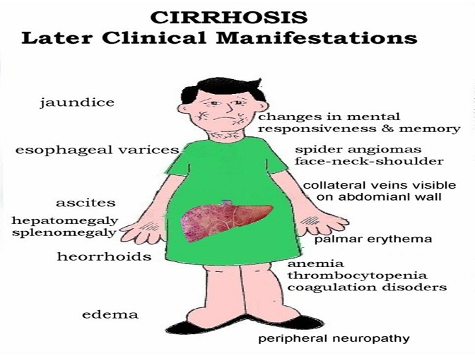

Slide 122
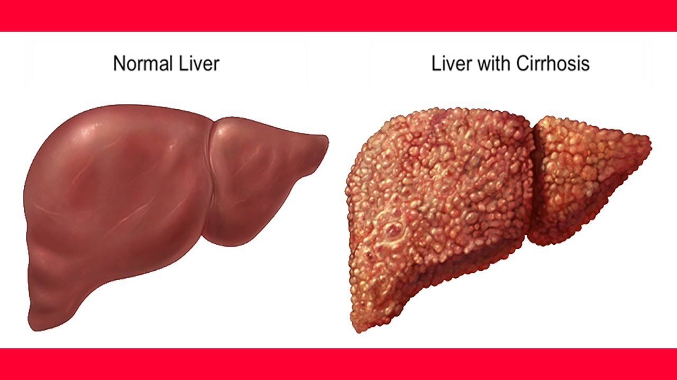

Slide 123
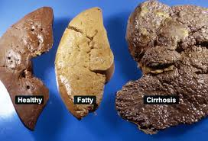

Slide 124
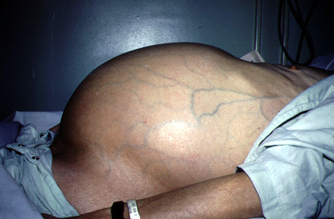
Ascites

Slide 125
S/S
Late
Foul breath
Jaundice
Fatigue
Pain
High Grade Fever
Loss of appetite
Edema
Anemia
Confusion
Early
generally feeling unwell and tired all the time
loss of appetite
loss of weight and muscle wasting
feeling sick (nausea) and vomiting
tenderness/pain on the RUQ
spider-like small blood capillaries on the skin above waist level (spider angiomas)
blotchy red palms
disturbed sleep pattern

Slide 126
Diagnosis
Blood tests
LFTs: should include SGOT (serum glutamic oxaloacetic transaminase ) aspartate transaminase (AST), alanine transaminase (ALT), alkaline phosphatase (ALP), bilirubin, gamma-glutamyltransferase (gamma-GT); AST and ALT are raised due to hepatocyte damage; gamma-GT is high in active alcoholics.
Albumin: there is hypoalbuminaemia in advanced cirrhosis.
FBC: occult bleeding may produce anaemia; hypersplenism may cause thrombocytopenia; macrocytosis can suggest alcohol abuse.

Slide 127
Renal function tests and electrolytes: hyponatraemia may be present (due to increased activity of antidiuretic hormone). Poor renal function may represent hepatorenal syndrome.
Red cell folate: alcohol abuse is often associated with a diet inadequate in folate.
Coagulation screen: abnormalities of coagulation are a sensitive test of liver function; prothrombin time is reduced in advanced cirrhosis.
Ferritin: low ferritin may indicate iron deficiency from diet or blood loss; ferritin is raised in haemochromatosis

Slide 128
Viral antibody screen for hepatitis
U/S
P/E
Chest x-ray will show a raised diaphragm

Slide 129
Management
Nothing can reverses the damaged liver cells state
Treatment aims at preventing the progression and providing symptomatic relief
the patient should be placed on a diet containing at least 1 g protein per kilogram of body weight and 8500 to 12,500 kJ (2000 to 3000 kcal) per day
Administration of albumin to maintain osmotic pressure

Slide 130
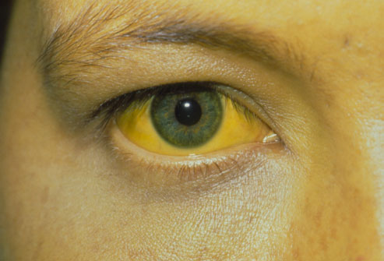
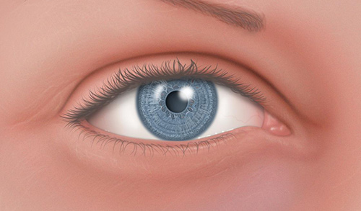
JAUNDICE
Yellowish coloration of the skin, sclera and mucous membrane. Different methods of classification:

Slide 131
Classification of jaundice
According to source in relation to the liver:
Pre hepatic: Hemolysis
Hepatic: Infection in the liver
Post hepatic: Block to bile flow from gall bladder

Slide 132
According to cause
Pathological: Infection e.g malaria
Physiologic: Neonatal RBC hemolysis
Obstructive: Gall bladder stones

Slide 133
Conjugation of bilirubin
Breakdown of RBC’S haem>biliverdin> bilirubin
in the Liver it is conjugated with glucoronic acid by enzyme glucuronyltransferase making it soluble in water. Much of it goes to the bile and out into the small intestine. The conjugated bilirubin is not absorbed and passes into the colon and gives the color of the stool

Slide 134
Causes
Breakdown of RBCS
Damage of the liver/muscles
Under absorption of bilirubin by GIT
Investigations
Bilirubin levels
LFTS
Complete blood count

Slide 135
LFTs Normal values

Slide 136
-Abdominal U/S
-Abdominal CT
-Percutaneous transhepatic cholangiogram
-Liver biopsy
-Cholesterol levels

Slide 137
Prothrombin time
Hepatitis A,B,C tests
Endoscopic retrograde cholangiopancreatography

Slide 138
Clinical manifestations
Yellowish coloration of the sclera, skin and mouth
Dark or brown coloured urine
Pale or clay coloured stools
Pruritus
Weight loss
Abdominal pain
Fever
Management
NB according to the cause

Slide 139
HEPATITIS
Inflammation of liver tissue
The most common types are viral. A,B,C
Many cases are asymptomatic and therefore remain undiagnosed.
Pathophysiology
The virus enters the liver cells causing degenerating
Changes. Inflammation process follows
Accompanied by exudates containing lymphocyte, plasma cells and granulocytes.

Slide 140
There is reactive hyperplasia of the macrophages in the sinusoids. Later there is necrosis of the liver cells and tissue. Macrophages tries to remove the necrotic materials causing the collapse of the lobules. Blood supply in the lobules is interfered with causing hypoxia and further liver damage.

Slide 141
HEPATITIS A
Caused by RNA virus
Spread through the oral faecal route
Clinical manifestations
Flu like symptoms
Low grade fever
Anorexia
Jaundice
Dark urine
Splenomegally

Slide 142
Management
Complete bed rest
IV fluids
Diet low in protein
Gradual mobilization
Health education
Other nursing care as per the patient needs

Slide 143
Prevention
Administration of hepatitis A vaccine

Slide 144
HEPATITIS B
Caused by DNA virus
Spread through blood, mucous membrane and skin
Also found in semen and vagina
Predisposed people
Health workers
Patients on hemodialysis
Homosexuals
IV drug abusers

Slide 145
Clinical manifestations
Fever
Rashes
Arthralgia
Anorexia
Dyspepsia
General malaise and weakness
Jaundice
Hepatomegally
Splenomegally

Slide 146
Management
Complete bed rest
Diet restricted in protein
Medication( antacids, antiemetics, antispasmoidals)
Ambulation
Involve family in care

Slide 147
Patients education
Nutrition
Ways of transmission
Avoid alcohol
Protected sex

Slide 148
Prevention
Control chain of transmission
Early screening
Vaccination
Contact tracing
Treatment of the affected
Health education

Slide 149
HEPATITIS C & D
Hepatitis C
Is associated with blood infusions
Clinical symptom and management are like for hepatitis B
Hepatitis D
Only people with hepatitis B contracts the disease because this virus needs the antigen surface for hepatitis B to attach.
Transmission-sexual intercourse with an infected person
Symptoms and management are like in hepatitis B
Assignment –hepatitis E

Slide 150
Hepatitis C
Affect both the RNA and DNA strands
Target is the liver mostly the b lymphocytes
CAUSES
Sexual intercourse
Sharing needles
Blood and blood products
Mother to child transmission
Signs and symptoms
Usually asymptomatic

Slide 151
PORTAL HYPERTENSION
Its an increase in pressures in the portal system above 5mm/hg.
Review of Portal circulation
The hepatic portal vein drains venous blood from the gastrointestinal tract, spleen, pancreas, and gallbladder to the sinusoids of the liver; from here, the blood is conveyed to the systemic venous system by the hepatic veins that drain directly to the inferior vena cava.

Slide 152
Causes
Liver cirrhosis
Blood clot in the portal vein
Blockage of veins that carry blood from the liver to the heart
Parasitic infections (schistosomiasis)

Slide 153
Causes
Pre hepatic
Intra hepatic
Post hepatic

Slide 154
Pathophysiology
Blockage of vessels high pressures in portal system varices, umbilical hernia. The portal vein drain blood from the stomach intestine, spleen and it is usually under low pressure five to ten mmhg. Any obstruction to blood flow may cause the blood to rise. Obstruction lead to esophageal, gastric and hemorrhoid varicose veins due to increased venous pressure and there is accumulation of fluid in the abdominal cavity; ascites.

Slide 155
Symptoms
GI bleeding dark stool
Splenomegaly
Ascites
Encephalopathy/confusion
Reduced platelets, reduced WBC cells
Liver biopsy
Hepatic venous wedge pressure
Abnormal LFTS

Slide 156
Investigations
MRIS
Ultrasound
Doppler ultrasound
Management
Endoscopic therapy
Banding; block bld vessels with a rubber band
Sclerotherapy; a blood clotting solution is injected into the bleeding varices to stop bleeding

Slide 157
Management
Medication
Beta blockers e.g. propranolol
Vasopressin
Octreotide

Slide 158
CA LIVER
Causes
Hepatitis B virus
Hepatitis C virus
Cirrhosis
Smoking
Chemical agents

Slide 159
Clinical features
Diagnosis
Abdominal u/s
CT scan
Arterial partography
Liver biopsy
LFTS
Anorexia
Nausea and vomiting
Weakness and general malaise
Abdominal mass
Splenomegally
Hepatomegally
Ascites
Jaundice

Slide 160
Management Surgical
Wedge resection
Lobectomyresection
Major liver resection
Total hepatoctomy and liver transplant
Cryotherapy
Chemotherapy
-Regional
Intra –arterial
Radiation

Slide 161
Pancreatitis
Pancreatitis is a disease in which the pancreas becomes inflamed. Pancreatic damage happens when the digestive enzymes are activated before they are released into the small intestine and begin attacking the pancreas

Slide 162
1. PANCREATITIS Acute Chronic
Pancreatitis is the inflammation of the pancreas leading to the obstruction of the pancreatic juices.
Predisposing factors to acute
Gallstones
Alcohol
Viral infections e.g. Mumps
Abdominal trauma

Slide 163
Signs and symptoms
Investigations
Serum amylase/lipase
Full hemogram
Urinalysis
Serum calcium
Peritoneal tap
X-ray
Ultra sound
Abdominal pain
Unexplained abdominal mass
Vomiting
Fever
Jaundice
Respiratory distress

Slide 164
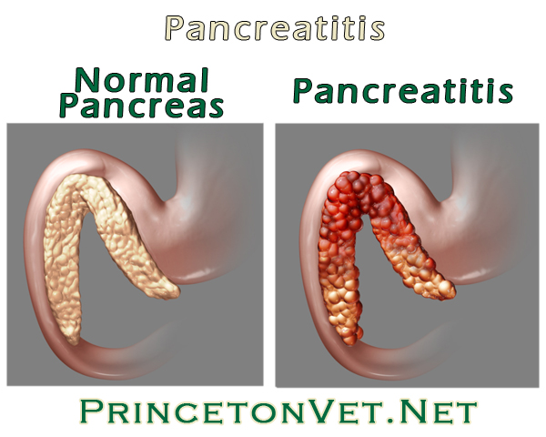

Slide 165
COMPLICATIONS
Pseudo cysts
Infected pancreatic necrosis
Systemic inflammatory syndrome; xterised by fever, tachypnea, tachycardia.

Slide 166
Management
Pain relief
Insulin
Fluid/electrolyte balance
Gastric suction
Respiratory care
Pancreatectomy

Slide 167
Chronic pancreatitis
Inflammatory disorder characterized by progressive anatomic and functional destruction of the pancreas.
Risk factors
Chronic alcohol consumption

Slide 168
Symptoms
Investigations
OGTT
CT scan
MRI
X-ray of the abdomen
Endoscopy
Severe abdominal pains
Weight loss
Steatorrhoea

Slide 169
COMPLICATIONS
Diabetes
Jaundice
Pseudocyst
Cancer of the Pancreas

Slide 170
Management
Hypoglycemics and insulin
Pancreatic enzyme replacement
Diet low in proteins
Pancreaticojejunostomy
Health education

Slide 171
HEMMORHOIDS
Are dilated portions of veins in the anal canal.
Incidence increases with an increasing age
CAUSES
Shearing of the mucosa during defecation- results in the sliding of the structures in the wall of the anal canal
Increased pressure in the hemorrhoidal tissue due to pregnancy may initiate hemorrhoids or aggravate existing ones.
Risk factors
Pregnancy
Low fiber diet
Obesity
Age>60years

Slide 172
May be internal or external
above the internal sphincter -internal hemorrhoid
outside the external sphincter- external hemorrhoids
Classification according to degree of prolapse
First degree-
Second degree
Third degree
Fourth degree

Slide 173
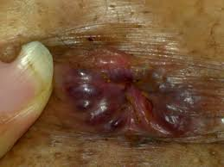
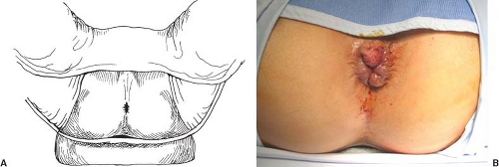
Patients in lithotomy position with hemorrhoids

Slide 174
CONSEQUENCES/clinical manifestations
Anal itching
Local edema
pain due to inflamation
bright red bleeding with defecation
Thrombosis/clotting within hemmorhoids-may cause local tissue ischemia
May prolapse when severely enlarged can cause massive bleeding

Slide 175
MANAGEMENT
good personal hygiene
avoiding excessive straining during defecation
high-residue diet that contains fruit and bran
increased fluid intake
addition of bulk-forming agents - psyllium and mucilloid
Warm compresses, sitz baths allow the engorgement to subside

Slide 176
Complications of hemmoroids
Anaemia
Strangulated hemmorhoid

Slide 177
Diarrhea (Gastroenteritis)
Is the 3rd major killer condition in the under 5 after malaria and pneumonia
Causes death due to dehydration and electrolyte imbalance
Predisposing factors
Poor sanitation
Bottle feeding
Prematurity and low birth weight
Weaning

Slide 178
Classification
Acute diarrhea
Severe persistent diarrhea
Persistent diarrhea
Diarrhea
Etiology
Infectious agents
Viruses – are the most common cause
Rotavirus accounts for > 50% of childhood diarrhea
Other viruses include – measles, adenovirus
Bacteria – Vibrio cholerae, Yersinia pestis, Escherichia coli
Fungi – Candida albicans
Protozoa – Guardia lamblia, Entamoeba histolytica

Slide 179
Infections outside the GIT e.g. sepsis which cause parenteral diarrhea
Anatomic defects e.g. after gastrectomy
Hepatic or pancreatic diseases
Tumors of the GIT e.g. cancer of the stomach
Immunodeficiency e.g. in AIDS
Dietary causes e.g. lactose intolerance
Drugs e.g. antibiotics, laxatives, magnesium based antacids

Slide 180
Acute Diarrhea
Is caused by Shigella and Salmonella species
They cause diarrhea through several mechanisms:
Destruction of intestinal cells causing reduced fluid and food absorption
Adhering to intestinal cells causing reduced fluid and food absorption
Production of toxins which inhibit water absorption and increase exudation

Slide 181
Pathophysiology
GI disturbance, reduced absorption of fluid and increased exudative secretion of fluids (serum exudates) into the intestines causes diarrhea
This may lead to dehydration and increased fluid requirements
Diarrhea causes electrolyte imbalance. The body compensates by reducing urine output. If the dehydration is severe fluid is taken from other body compartments and directed to the kidney leading to manifestations of dehydration such as sunken eyes and dry mucous membranes
Shock may also result due to respiratory acidosis which causes rapid shallow respirations

Slide 182
Normal Physiologic Daily Fluid Requirement in Children
Preterm – 200ml/Kg/day
A child up to 10kg – 150ml/Kg/day
A child > 10kg – 100ml/Kg/day

Slide 183
Clinical manifestations
Reduced urination of concentrated urine
Rapid weight loss
On examination
Sunken eyes and dry mouth
Polydipsia in moderate dehydration, and inability to feed in severe dehydration
Restlessness and irrtability
Sunken fontanelles
Rapid acidotic respirations (Kussmaul breathing)
Rapid weak pulse
Coma

Slide 184
Diagnosis
Hx and physical exam
Lab investigations
Serum electrolytes
Stool for culture and microscopy
Management
Antibiotics – are not indicated unless in dysentry or persistent diarrhea and proven amoebiasis and guardiasis
Diarrhea for more than 14 days may be complicated by intolerance of ORS and requires IV rehydration
All children with diarrhea require zinc sulphate
Assess for shock – cold hands, weak and absent pulses, capillary refill > 3 seconds, AVPU less than A. If present administer give N/S 20ml/Kg over 15 mins as a bolus which may be given up to 4 times or until improvement is noted e.g. pulse is felt
Treat hypoglycemia with 10% dextrose 5ml/Kg
If Hb < 5g/dL transfuse urgently with whole blood 20ml/Kg body weight

Slide 185
In Severe Dehydration
Child unable to drink, AVPU < A, sunken eyes, child unconscious, skin pinch takes > 2 seconds
Manage the child with Plan C i.e.
Step 1
IV ringers lactate 30ml/Kg over 60 mins (for an infant < 12 months) or 30 mins (for a child > 12 months)
If unable to access IV administer ORS 20ml/Kg/hr via NG tube over 6 hours
THEN
Step 2
Administer IV R/L 70ml/Kg over 5 hrs (for infants < 12 months) or 2 ½ hrs (for children > 12months)
Re-assess and re-classify after 3 – 6 hrs. If there’s some dehydration and the child is able to drink adequetately but still has 2 or more of the following signs (sunken eyes, skin pinch return 1-2 sec, restlessness, irritabilty) use plan B

Slide 186
Plan B (Moderate diarrhea)
Give ORS orally at 75ml/Kg over 4 hrs
Continue breastfeeding as tolerated
Zinc sulphate 10mg OD ( < 6months) or 20mg OD (> 6 months) for 10 -14 days
Re-assess after 4hrs and treat as per classification
If child has diarrhea but with no dehydration or fewer than 2 of the above signs of dehydration manage the child using Plan A
Plan A (Mild or no dehydration with diarrhea)
10ml/Kg of ORS after every loose stool
Continue breastfeeding or encourage feeding for an infant or child > 6 months
Administer zinc sulphate tabs 10mg OD(infants < 6months) or 20mg OD (if > 6 months) for 10 – 14 days
Educate the parents about the possible cause of the diarrhea, prevention and management by calculating fluid according to body weight
Daily weighing of all infants < 12 months

Slide 187
CROHN’S DISEASE
Crohn's Disease causes inflammation of the bowel. It most commonly affects the lower small intestine (ileum) and the large intestine (colon), but may involve any part of the digestive tract from the mouth to the anus. The inflammation extends through the entire thickness of the bowel wall.

Slide 188
Pathophysiology
The immune system seems to overreact to substances and bacteria in the intestine. White blood cells invade the intestinal lining and produce inflammatory toxins causing chronic tissue swelling, injury and ulceration. The precise cause of this abnormal immune response is unknown.

Slide 189
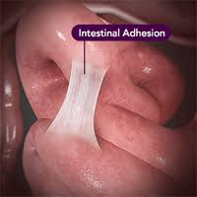
Causes
Complications
Adhesions
Obstruction
Malnutrition from poor absorption
Anal fissures
Fistula
Abnormal immune response
Genetical
Diagnosis
Colonoscopy

Slide 190
Management
Physical and psychological rest
Nutrition ( high calories, minerals, Vitamins, low fats, high fibers)
Fluid and electrolyte balance
Drugs-corticosteroids
Surgery

Slide 191
Ulcerative colitis
Is a recurrent ulcerative and inflammatory disease of the mucosal and sub mucosal layers of the colon and rectum
Approximately 5% of patients with ulcerative colitis develop colon cancer

Slide 192
Pathophysiology
Affects the superficial mucosa of the colon and it is characterized by multiple ulceration, diffuse inflammations and desquamation or shedding of the colonic epithelium. Bleeding occurs as a result of ulceration. The mucosa becomes inflamed and edematous. Abscess form. The process starts from the rectum then spreads to the whole colon.
Eventually the bowel narrows, shortens and thickens because of muscular hypertrophy and fat deposits

Slide 193
Predisposing factors
Any age, but more rampant in between 15 and 30 ^{yrs}
older than 60 ^{yrs}
Positive Family history
Jewish descent-challenged
Causes
Heredity
Overactive immunity
Drugs: Antibiotics, corticosteroids, NSAIDs,
Stress may trigger

Slide 194
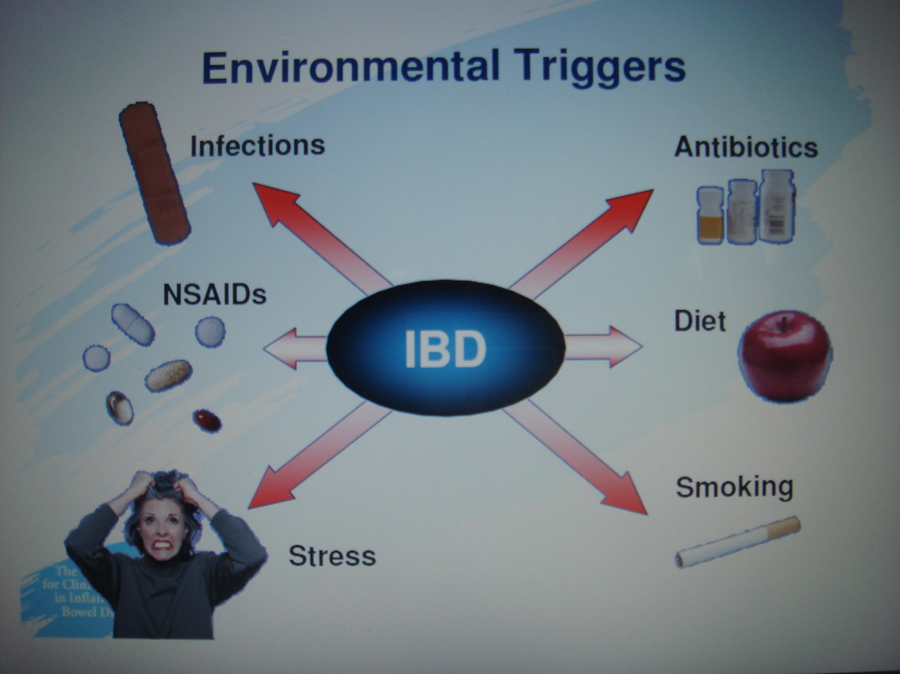

Slide 195
Clinical manifestations
Diarrhea
Passage of mucus and pus
Left lower quadrant abdominal pain
Intermittent tenesmus (pain during defecation)
Rectal bleeding
Anorexia and weight loss
Fever
Vomiting and dehydration

Slide 196
Assessment and diagnostic functions
Assess for tachycardia, hypotension, tachypnea, fever, and pallor
Abdominal examination -bowel sounds, distensions and tenderness
Stool is positive with blood
sigmoidoscopy

Slide 197
Management
The key thing in management of ulcerative colitis is to reduce inflammation, suppress inappropriate immune responses, provide rest for diseased bowel
Nutritional therapy
Oral fluids and low residue, high protein, high calorie diet with supplemental vitamin therapy and iron replacement.
Iv fluid to correct dehydration
Cold foods and smoking are avoided as they increase gastric motility

Slide 198
Pharmacology therapy
Sedatives, antdiarrheal and antiperistalitic medications are often effective to rest the inflamed bowel
Aminosalicyates such as sulfasalazine are used to reduce inflammation
Corticosteroids are used to correct fulminant and severe diseases

Slide 199
Surgical management
It involves removal of the affected region, 10 years after diagnosis managed with non surgical measures but has failed
Total colectomy with ileostomy. Ileostomy is the surgical creation of an opening into the ileum by diverting a portion of the distal ileum to the abdominal wall-stoma

Slide 200
Nursing interventions
Maintaining normal elimination patterns
Relieving pain
Maintaining fluid intake
Maintaining optimal nutrition
Promoting rest
Reducing anxiety
Enhancing coping measures
Preventing skin breakdown
Monitoring and managing potential complications
Promoting home and community based care

Slide 201
Complications:
Perforation,
Peritonitis,
Abscess
Toxic megacolon
Venous thrombosis
Carcinoma

Slide 202
Summary of Differences
Crohn’s disease
Inflammation may develop anywhere in the GIT
Common at the end of the small intestine
May appear in patches
May extend through entire thickness of bowel wall
About 67% of people in remission will have at least 1 relapse over the next 5 years
Ulcerative colitis
Limited to the large intestine (colon and rectum)
May involve a part of or the entire colon
Appears in a continuous pattern
Inflammation occurs in innermost lining of the intestine
About 30% of people in remission will experience a relapse in the following year

Slide 203
CHOLECYSTITIS
Cholecystitis-inflammation of the gall bladder
Associated with sedentary life style. Obese persons are more predisposed
Incidences are high at the age of 50’s and 60’s

Slide 204
The Gallbladder
Hollow organ that beneath the liver.
In adults, measures approximately 8 cm (3.1 in) in length and 4 cm (1.6 in) in diameter when fully distended.
Divided into three parts: fundus, body and neck.
The neck tapers and connects to the biliary tree via the cystic duct which then joins the common hepatic duct to become the common bile duct.
At the neck of the gallbladder is a mucosal fold called Hartmann's pouch, where gallstones commonly get stuck.

Slide 205
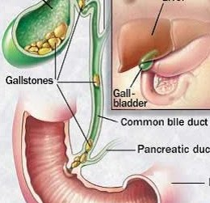

Slide 206
Cholecystitis is the inflammation of the gallbladder, usually resulting from a gallbladder stone blocking the cystic duct.
Lasts for long time and characterized by repeated attacks of pain (biliary colic).
It may become thick walled, scarred and small. The gallbladder usually contains sludge (a microscopic particles or materials similar to gallstones)
These block its opening into the cystic duct or reside in cystic duct itself.

Slide 207
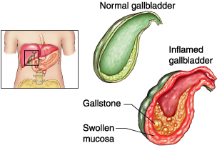

Slide 208
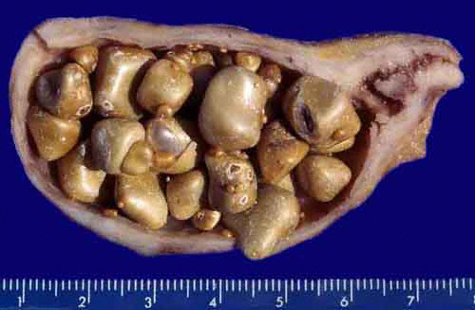
Notice thickness of gall bladder wall, abundant polyhedric stones
and small papillary tumor in the cystic duct.

Slide 209
Pathophysiology
Obstruction of the bile flow, more water absorption causing increased concentration of the bile and irritation of gall bladder
Bacteria and irritants are trapped thus further inflammation

Slide 210
Clinical features
Fever, tachycardia, and tenderness in the RUQ(right upper quadrant) or epigastric region, often with guarding or rebound.
The Murphy sign described as tenderness and an inspiratory pause elicited during palpation of the RUQ.
A palpable gallbladder or fullness of the RUQ .
Jaundice may be noted in approximately 15% of patients.
Patients with chronic cholecystitis frequently have a palpable RUQ mass secondary to fibrosis involving the gallbladder.

Slide 211
Pain : sharp, cramping, steady
Spread to the back or below the right shoulder blade
Other symptoms : clay-colored stools, fever, nausea or vomiting, yellowing of skin(jaundice)

Slide 212
Diagnostic
P/examination.
Ultrasonography is the best way to detect gallstones in the gallbladder or the thickening of its wall.

Slide 213
If possible, the patient should not eat for 6 or more hours before the test, which takes only about 15 minutes. During the procedure, the doctor can check the liver, bile ducts, and pancreas, and quickly scan the gallbladder wall for thickening (characteristic of cholecystitis.

Slide 214
…continue
Liver blood test are often normal unless the person has an obstructed bile duct. Other blood test can detect some complications such as high level of a pancreatic enzyme (lipase or amylase) in pancreatitis.
A high count of WBC suggest inflammation, an abscess, gangrene or a perforated gallbladder.

Slide 215
management
Surgical – removal of the gallbladder (cholecystectomy) is usually done by using a flexible tube called a laparoscope.
This surgery uses a smaller surgical cuts, which results in a faster recovery. Patients are often sent home from the hospital on the same day as surgery or the next morning. Open cholecystectomy requires larger cut in the upper-right part of the abdomen.
Gall stones may also be dissolved with medication taken by mouth. But may take 2 years or longer to work.

Slide 216
Complications
Pain after surgery : a few people have new or recurring episodes of pain that felt on gallbladder even thought the gallbladder and the stones have been removed.
It may be the malfunction of the sphincter of Oddi, the muscle that control the released of bile and pancreatic secretion.

Slide 217
Other possible complication
Cancer of gallbladder (rarely)
Jaundice
Pancreatitis
Worsening of the condition:
NB;The pancreas and liver drain into the same duct into the gut. When the pancrease becomes inflamed and swollen the outflow from the liver does not drain into the gut. The bile salts do not get into the gut and stay in the body leading to jaundice.

Slide 218
Management
The condition is not always preventable.
Eating less fatty food may relieve symptoms who have not had their gallbladder removed.

Slide 219
CHOLELITHIASIS
Dfn-collection or presence of stones in the gall bladder
Causes
Altered solubility of the bile content
High levels of blood and dietary cholesterol
Dm
Hemolytic diseases
Female gender
Obesity

Slide 220
Clinical manifestations
Intolerance to fatty foods
Nausea and vomiting
Flatulence
Fever
Right upper quadrant discomfort
Right upper quadrant pain
Jaundice
Clay colored stool
Dark colored urine

Slide 221
Diagnosis
A) cholecystitis
-High WBC
-High LFTs

Slide 222
B) cholelithiasis dx
X-ray
Cholecystogram
Cholangiogram
Ultrasonography

Slide 223
Management
Bed rest
Pain control
Antibiotics
Gallstone resolution therapy
Cholecystectomy
Cholecystotomy
Choledochostomy
Choledocholithotomy

Slide 224
Pre-op care
Restrict food or drinks
Skin preparation
Cleansing enema
Catheterization
Monitor prothrombin time
Administer vitamin k

Slide 225
Post-op care
Management of pain
Semi fowlers position
Splint incision site
Change dressing
Anti embolic stocking
Observe for bleeding
Vital signs
Other nursing care as per the patient’s needs
Health messages

